Slide 1
E-books and Audiobooks
Free access through your library
Janet Thatcher
February 2021

Slide 2
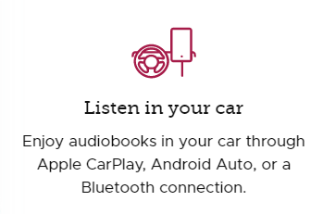
Books can be read and played on
Smartphone
Kindle
Computer, iPad and others

Slide 3
Libby App

Slide 4
Getting a Library Card
Black Gold Cooperative Library System
Online Registration for a Temporary card number
One year
Check out five items
Full digital privileges including placing holds
Receive a post card at your county residence and return it to get full borrowing privileges
California drivers license entitles you to a library card at any library in state. May have to wait for “normal” time to apply.

Slide 5
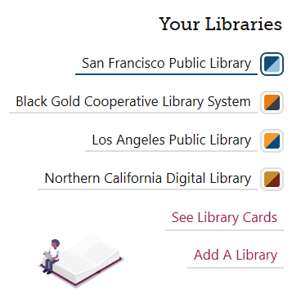

Slide 6
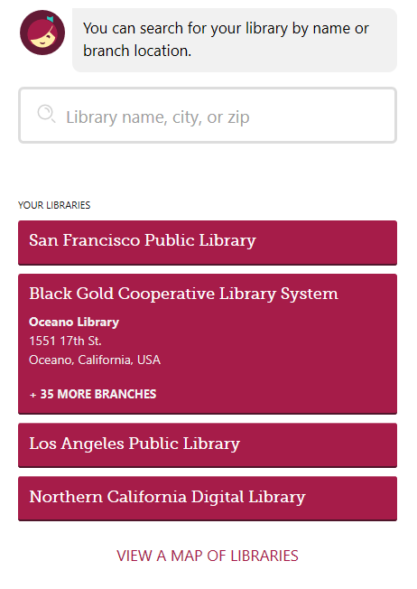
93401

Slide 7
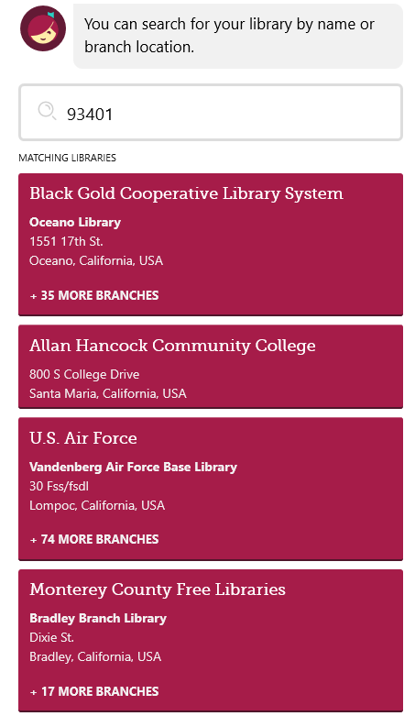

Slide 8
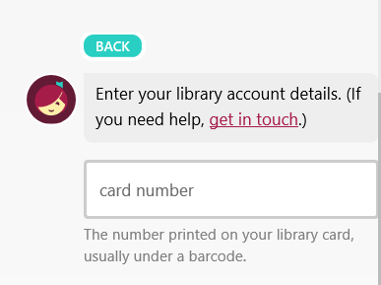

Slide 9
Search for a Book
Search
John Grisham

Slide 10
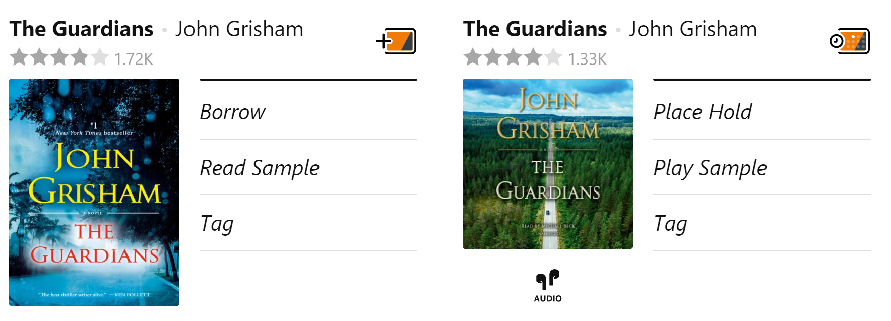

Slide 11
Borrow for 21 days

Slide 12
Place a Hold

Slide 13
Suspend a Hold
Use slider to suspend for up to 180 days.
Move to left to change to active.

Slide 14
Advantages of eBooks
Change to larger print
Bookmarks
Keeps your place across devices
Can download and read or listen offline
Reading with children
Other apps to access library books
Overdrive
Cloud Library

Slide 15
Other Digital Library Resources
Movies – Hoopla and Kanopy app
San Luis Obispo Tribune
New York Times – 24 hours of access that can be renewed
California DMV practice tests

